Slide 1
Machine Learning Basics: Linear Algebra, Probability and Information Theory
Hongkai Yu
Cleveland State University

Slide 2
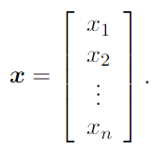


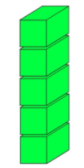
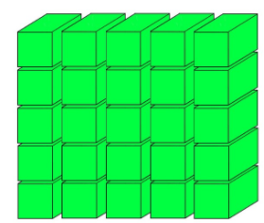
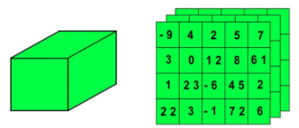
Linear Algebra
Scalars: A scalar is just a single number
Vectors: A vector is an array of numbers
Matrices: A matrix is a 2-D array of numbers, so each element is identiﬁed by two indices instead of just one.
Tensors: In some cases, we will need an array with more than two axes.
3D Tensor
4D Tensor
5D Tensor

Slide 3
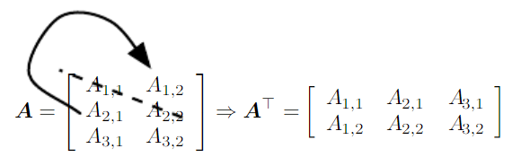








Linear Algebra
Matrix transpose:
Matrix computation:

Slide 4
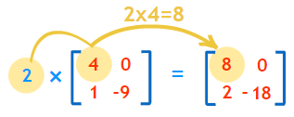


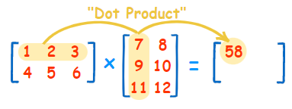

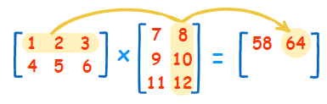
Linear Algebra
Matrix multiplication: Scalar*Matrix
Matrix multiplication:
A: m-by-n; B: n-by-p; C: m-by-p
https://www.mathsisfun.com/algebra/matrix-multiplying.html

Slide 5
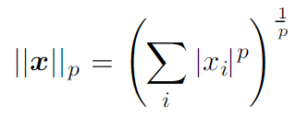



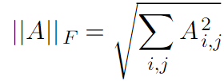
Linear Algebra
L_{p} norm
L₁ norm and max norm
Frobenius norm of a matrix: similar to L₂ norm of a vector

Slide 6
Probability
Bass weights of training data: 3, 4.9, 5, 2.5, 1.2, 6.1, 2.3, …
Salmon weights of training data: 13, 14.9, 15, 12.5, 11.2, 16.1, 12.3, …
New data for testing: 4.3, 12.3, 7.2, 8.4
Which class does it belong to?

Slide 7
Probability
Bass weights of training data: 3, 4.9, 5, 2.5, 1.2, 6.1, 2.3
Salmon weights of training data: 13, 14.9, 15, 12.5, 11.2, 16.1, 12.3
New data for testing: 4.3, 12.3, 7.2, 8.4
Which class does it belong to?
You have your intuition.
How to use some statistical machine learning methods for this task?

Slide 8
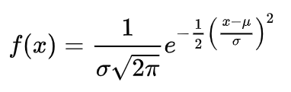
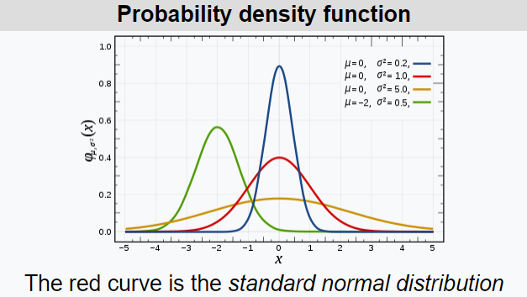
Gaussian Distribution
mean
standard deviation
If we know a Gaussian distribution, we can infer the relative likelihood given any new data sample.

Slide 9
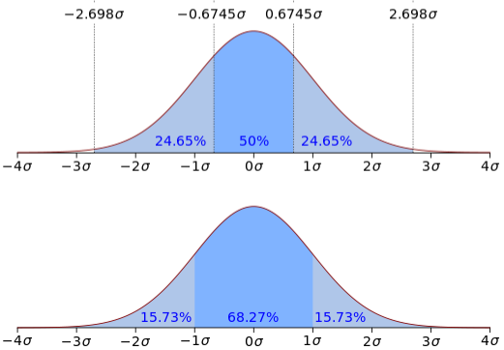
Gaussian Distribution
Probability density function (PDF) of a Gaussian Distribution

Slide 10




Bayes theorem
Observation:
Class:

Slide 11
Bayes classifier-Maximum a Posteriori (MAP)
Observation:
Class:
Optimization: Choose the class with the maximum posterior probability.

Slide 12
Gaussian Distribution: Single-variate
The observation only has the single-variate feature, for example, a bass has one feature of weight in the previous example.
mean
standard deviation
If we know a Gaussian distribution, we can infer the relative likelihood given any new data sample.

Slide 13

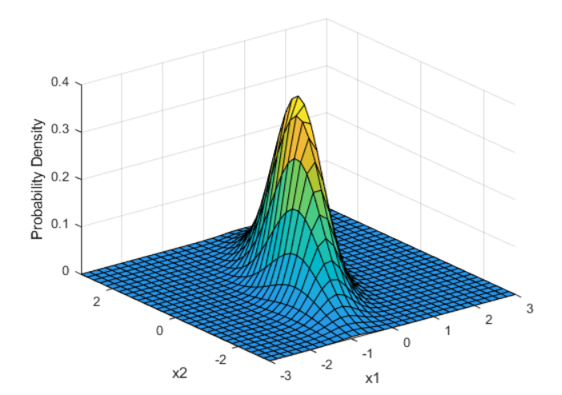
Gaussian Distribution: Multivariate
The observation might have multivariate features, for example, a bass has the features of weight, length, age, color, …, etc.
x [x₁, x₂, …, x_{d}]
mean
covariance matrix
d feature dimension

Slide 14
Gaussian Distribution: Multivariate
The observation might have multivariate features, for example, a bass has the features of weight, length, age, color, …, etc.
x [x₁, x₂, …, x_{d}]
mean
Mahalanobis Distance
Distance of one multivariate observation to a Multivariate Gaussian Distribution
covariance matrix
d feature dimension

Slide 15
Gaussian Mixture Model
A Gaussian Mixture Model (GMM) is a probabilistic model that assumes all the data points are generated from a mixture of a finite number of Gaussian distributions with unknown parameters.
https://sandipanweb.wordpress.com/2017/03/19/hard-soft-clustering-with-k-means-weighted-k-means-and-gmm-em/?frame-nonce=3f50ed1cb9

Slide 16
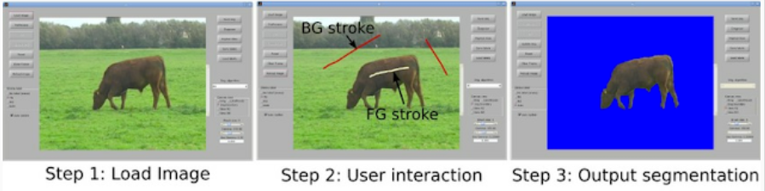
GMM for image segmentation
In many image segmentation tasks, it is important to represent the foreground/object and background models.
Learn a GMM model for the foreground GMM with k1 components.
Learn a GMM model for the background GMM with k2 components.
http://bitsearch.blogspot.com/2012/07/datasets-for-interactive-segmentation.html

Slide 17

Entropy
Given a discrete random variable, Entropy is a way to describe its uncertainty:
Maximum uncertainty/entropy is obtained by equal distribution.
Minimize entropy means to minimize the uncertainty.
Entropy_of_P = -1*np.sum(np.array(P)*np.log2(P))
P=[0.98,0.01,0.01], Entropy of P: 0.1614
Q=[1/3,1/3,1/3], Entropy of Q: 1.5850
For the classification problem, smaller entropy is desirable no matter you have the ground-truth label or not.

Slide 18
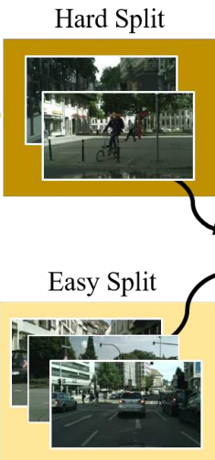
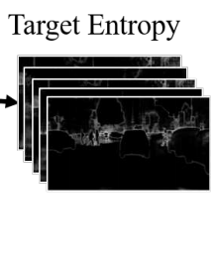
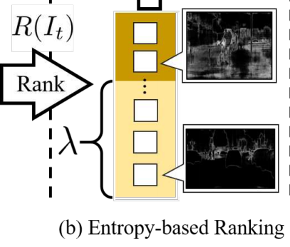

Entropy: example applications
Given a discrete random variable, Entropy is a way to describe its uncertainty:
For the supervised classification problem, cross-entropy loss is minimized to train the machine learning model.
For the classification problem without ground-truth label, we can still minimize entropy to minimize the uncertainty. Because we want the sparse classification confidence distribution, like [0.98,0.01,0.01].
Entropy/uncertainty can be used to unsupervised evaluation[*].
[*] Pan, et al. Unsupervised Intra-domain Adaptation for Semantic Segmentation through Self-Supervision, CVPR2020.

Slide 19

Kullback–Leibler Divergence
How to compute the distance of two distributions?
In mathematical statistics, the KL Divergence, (also called relative entropy), is a measure of how one probability distribution is different from a second, reference probability distribution.
Smaller KL Divergence means more similar distribution.
KL_Divergence(P, Q) is not equal to KL_Divergence(Q, P).
P=[9/25,12/25,4/25];
Q=[1/3,1/3,1/3];
KLD_P_Q=np.sum(np.array(P)*np.log2(np.array(P)/np.array(Q)))

Slide 20
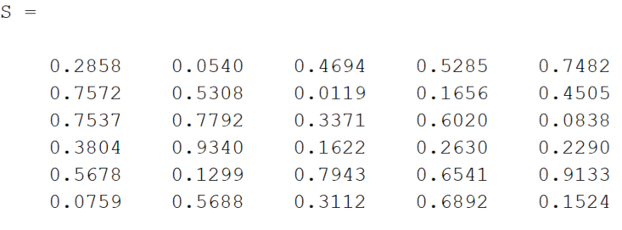
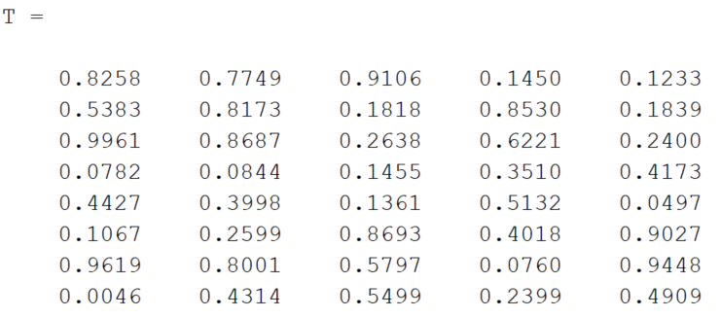
Maximum Mean Discrepancy(MMD)
How to compute the distance of two distributions?
MMD is another distance measure between two distributions.
Smaller MMD means more similarity.
Source-domain features
MMD is a value, e.g., 0.2145
Target-domain features

Slide 21
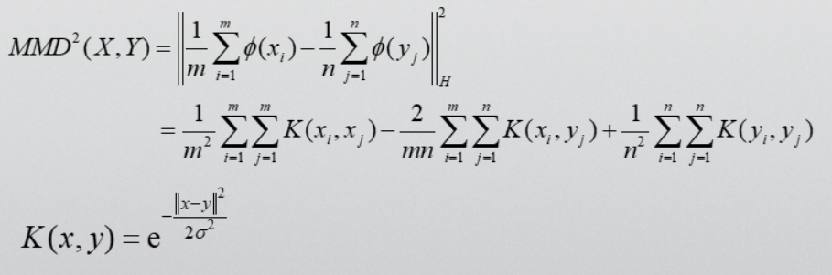
Maximum Mean Discrepancy(MMD)
How to compute the distance of two distributions?
MMD is another distance measure between two distributions.
Smaller MMD indicates more similarity.
MMD: Distance between mean embeddings of features.
H is the Reproducing Kernel Hilbert Space (RKHS).

Slide 22
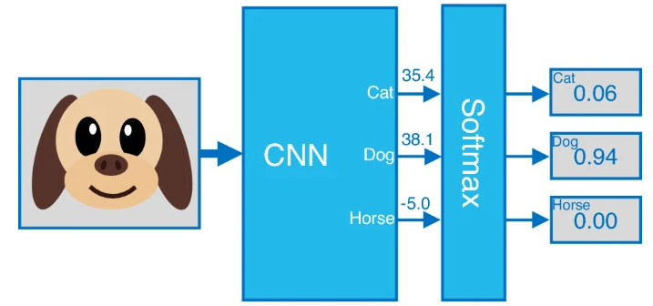

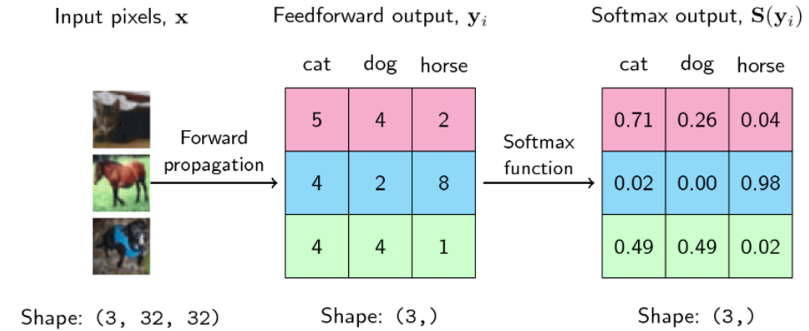
Softmax function
Normalization and Probability:
https://ogunlao.github.io/2020/04/26/you_dont_really_know_softmax.html
https://www.nature.com/articles/s41598-021-94691-7

Slide 23
References:
https://en.wikipedia.org/
https://www.mathworks.com/help/stats/
https://www.deeplearningbook.org/
Thank you!

